Slide 1
Azure Data Lake

Slide 2
Agenda
10-10:30 - Subscription Change
10:30-10:45 - Data Bricks complete Revise and Agenda
11:00 - 11:30 - Data Lake Basics
11:30-12:00 - Hands on Data Lake 1
12:00 - 12:30 - Hands on ADL 2 Query
12:30 - 1 - ADB with Data Lake Integration
2:00- 3:00 - Data Bricks ETL
3:00 - 4:00 - Data Bricks Streaming
Delete Subscriptions

Slide 3
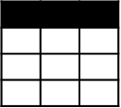
Evolving Approaches to Analytics EDWs to Data Lakes
Extract
Transform
Load
OLTP
…
EDW
(SQL Svr, Teradata, etc)
Original Data
ETL Tool
(SSIS, etc)
Transformed Data
BI Tools
ERP
LOB
Data Marts
Data Lake(s)
Dashboards
Apps

Slide 4
Evolving Approaches to Analytics EDWs to Data Lakes
Extract
Transform
Load
OLTP
…
EDW
(SQL Svr, Teradata, etc)
Original Data
ETL Tool
(SSIS, etc)
Transformed Data
BI Tools
ERP
LOB
Data Marts
Data Lake(s)
Dashboards
Devices
Social
Ingest (EL)
Apps
Sensors
Original Data
Web

Slide 5
Evolving Approaches to Analytics EDWs to Data Lakes
Extract
Transform
Load
OLTP
…
EDW
(SQL Svr, Teradata, etc)
Original Data
ETL Tool
(SSIS, etc)
Transformed Data
BI Tools
ERP
LOB
Data Marts
Data Lake(s)
Dashboards
Devices
Social
Ingest (EL)
Scale-out Storage & Compute
(HDFS, Blob Storage, etc)
Apps
Sensors
Original Data
Web
Streaming data
Transform & Load

Slide 6
Evolving Approaches to Analytics EDWs to Data Lakes
Extract
Transform
Load
OLTP
…
EDW
(SQL Svr, Teradata, etc)
Original Data
ETL Tool
(SSIS, etc)
Transformed Data
BI Tools
ERP
LOB
Data Marts
Data Lake(s)
Dashboards
Devices
Social
Ingest (EL)
Scale-out Storage & Compute
(HDFS, Blob Storage, etc)
Apps
Sensors
Original Data
Web
Streaming data
Transform & Load

Slide 7
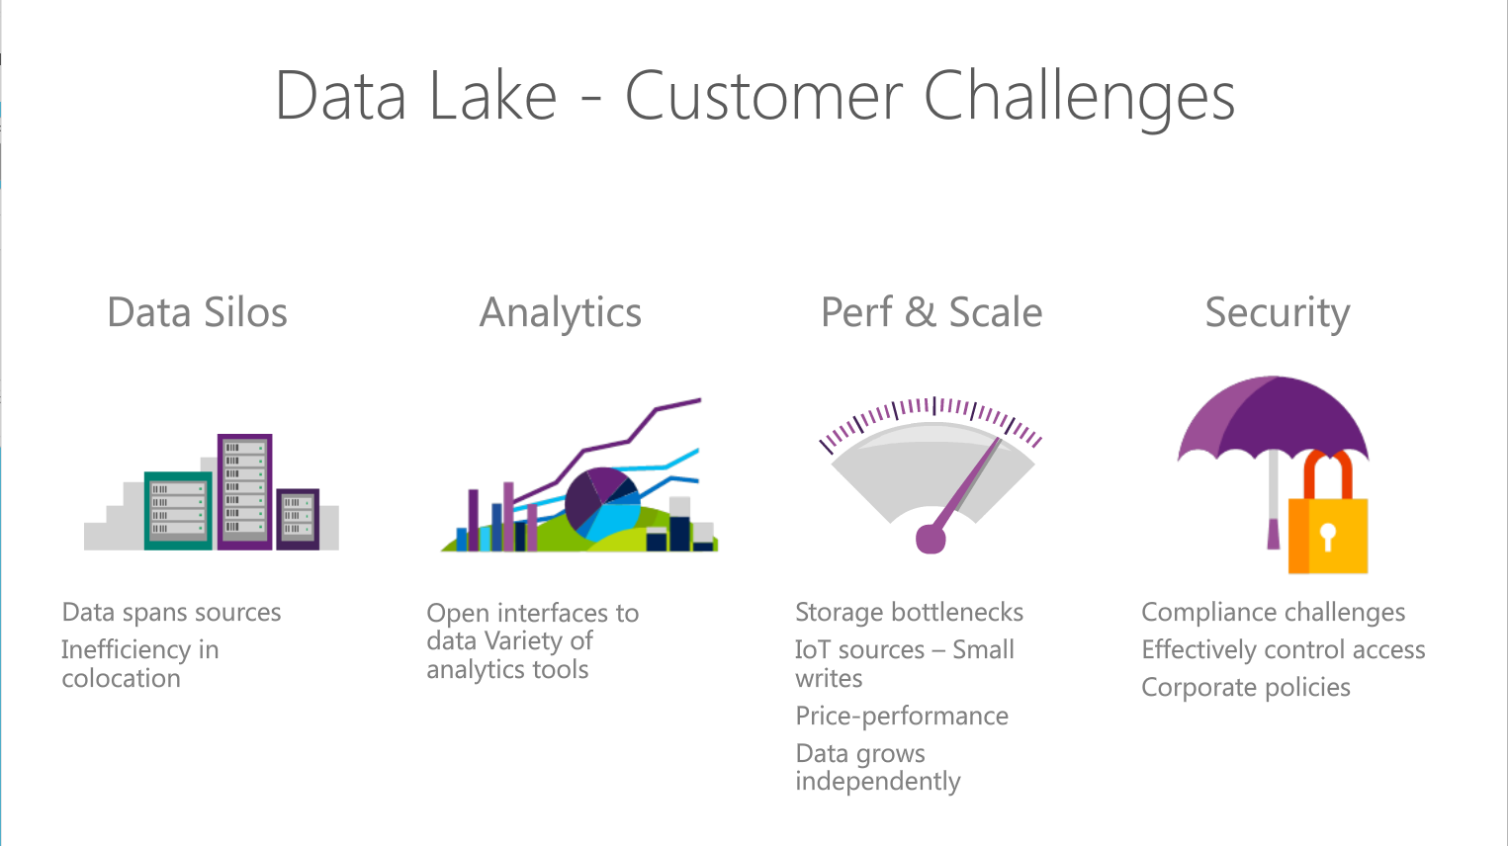
Notes:
Objetive – explain what are the Customer challeges that Azure Data Lake solution addresses
Read through the points.

Slide 8
The 3 Azure Big Data Services
HDInsight
Analytics
Store
Clusters as a service
Big data queries as a service
Hyper-scale Storage optimized for analytics
Big data as a service,
Cluster-less – no infrastructure to manage
Notes:
Slide objective – explain which services make up Azure Data Lake offering. The presentation will focus on Azure Data Lake Store and Analytics.
Talking points there are 3 main services in Azure

Slide 9
The Intelligent Lake
Petabytes of Data + Intelligence
Data Lake Store
No-limits data Lake
Petabyte-sized files
Trillions of objects
Scalable I/O for parallel analytics
Enterprise-grade Security
Data Lake Analytics
Analytics job service
Scale instantly
Scale per job
Infused with Artificial Intelligence

Slide 10
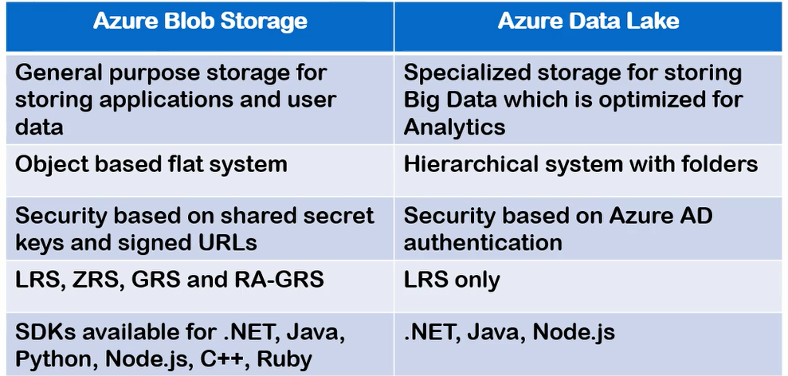
Azure Data Lake Storage Gen 1

Slide 11
Azure Data Lake Storage Gen 2
Performance:
The hierarchical namespace greatly improves the performance of directory management operations, which improves overall job performance.
Management :
Organize and manipulate files through directories and subdirectories.
Security :
Enforceable because you can define POSIX permissions on directories or individual files.
Cost effectiveness :
Built on top of the low-cost Azure Blob storage.

Slide 12
ADLS Gen1 + BLOB = ADLS Gen 2
Use | Data Lake Store | Blob Storage | Data Lake Gen 2
Hot/Cold Storage Tiers | No | Yes | Yes
Redundant Storage | No | Yes | Yes
AD Security | Yes | No | Yes
HDFS Compatible | Yes | No | Yes

Slide 13
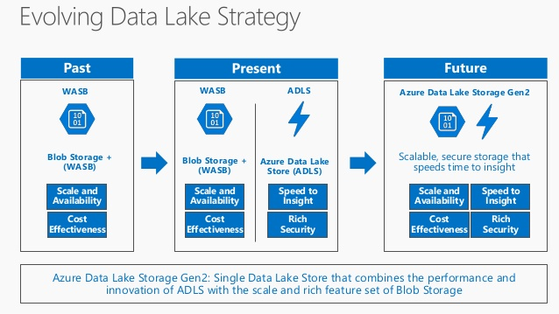
ADLS Gen1 + BLOB = ADLS Gen2

Slide 14
Azure Data Lake Use Cases

Slide 15
Data Lake Analytics Scenario
ON-PREMISES
AZURE
CONSUMPTION
Data Lake
Web Portals
Customer Behavior
Store
ETL & Analytics
Cleanup, Normalize, Basic Stats
Experimentation
A/B testing at scale. Drive changes based on actual
Customer behavior
Machine Learning
Do ML at Scale (Customer Segmentation & Fraud Detection)
SQL DW
Analytics
Move via Data Factory
Mobile Apps
Move via Data Factory
SQL DB
Clickstream
HDInsight
Power BI
DBs
Data Science
Notebooks
Notes:
Discuss how Azure data Lake fits into analytics scenarios

Slide 16
Retail Scenario Implementation
ON-PREMISES
CLOUD
CONSUMPTION
Massive Archive
Web Portals
Initial one time import
“Landing Zone”
Data Lake Store
DW (many instances)
On-Prem HDFS
Mobile Apps
via AzCopy
Curated Data
Data is portioned into multiple SQL DWs (one per data consumer. Several hundred consumers)
Power BI
Incremental
updates
Experimentation
Machine Learning
A/B testing at scale. Drive changes based on actual
Customer behavior
Do ML at Scale (Customer Segmentation & Fraud Detection)
Active Incoming Data
Jupyter
Notebooks
Notes:
Discuss how the previous scenario can fir into a concrete scenario for retail sector .
Here we use ADLS as store to where dat is uploaded from on-premise HDFS cluster and it analysed to extract additional insight using machine learning techniques
To do fraud prediction or customer segmentation. The data can then be suploaded to SQL data warehose to which various clients connect to conume data.

Slide 17
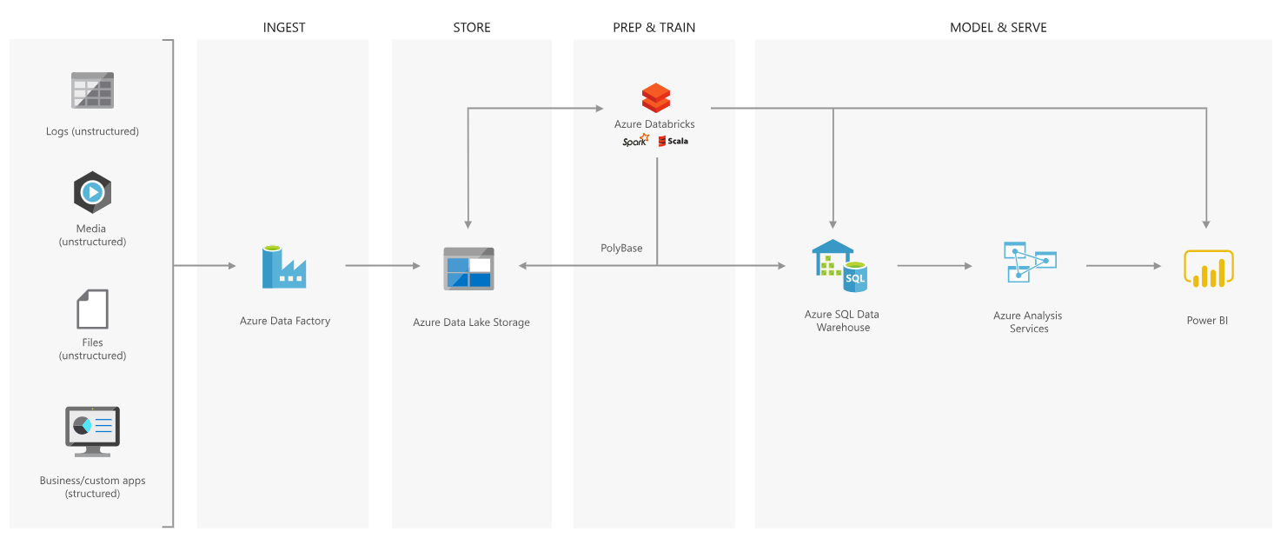
Best Practices – Modern Data Warehouse

Slide 18
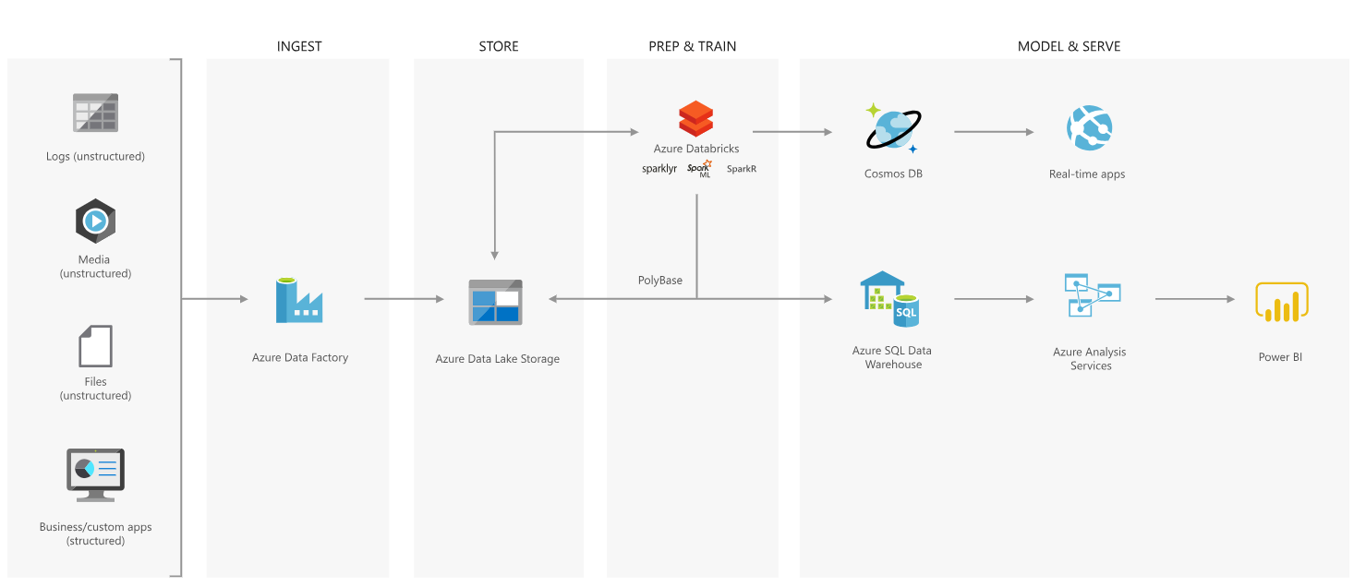
Advanced Analytics Approach

Slide 19

Azure Data Lake Store
Notes:
Lets have a look at the Data Lake Store service in more detail

Slide 20
Introducing Azure Data Lake Store
A hyper-scale repository for big data analytics workloads
Store ANY DATA in its native format
HADOOP FILE SYSTEM (HDFS) for the cloud
ENTERPRISE GRADE
No limits to SCALE
Optimized for analytic workload PERFORMANCE
Notes:
Objective: This is the introductory slide for Azure Data Lake Store.
Talking Points:
Microsoft describes Data Lake Store as a “hyper-scale repository for big data analytic workloads.” Azure Data Lake Store is an enterprise wide hyper-scale repository for big data analytic workloads.
Any Data - This lets you store all of your data and analyze them in their native format.
Hadoop File System - Azure Data Lake Store is a Hadoop file system which is compatible with HDFS and works with the Hadoop ecosystem.
Enterprise Grade - Azure Data Lake Store provides industry standard availability and reliability and also provides enterprise grade security for all data.
Scale - Azure Data Lake Store provides unlimited storage and is suitable for storing a variety of data.
Performance - Azure Data Lake Store is built for running large scale analytic systems that require massive throughput to query and analyze large amounts of data.

Slide 21
The Data Lake Approach
Ingest all data regardless of requirements
Store all data
in native format without schema definition
Do analysis
Using analytic engines like Hadoop and ADLA
Devices
Social
Batch queries
LOB applications
Video
Devices
Interactive queries
LOB applications
Social
Sensors
Real-time analytics
Web
Sensors
Video
Machine Learning
Relational
Web
Clickstream
Data warehouse
Relational
Clickstream
Notes:
Motivation – explain that ALS Store is Load Transform and Extract rather than ETL. You essentially postpone the schema definition until the extraction time.
A data lake is an enterprise wide repository of every type of data collected in a single place. Data of all types can be arbitrarily stored in the data lake prior to any formal definition of requirements or schema for the purposes of operational and exploratory analytics. Advanced analytics can be done using Hadoop, Machine Learning tools, or act as a lower cost data preparation location prior to moving curated data into a data warehouse. In these cases, customers would load data into the data lake prior to defining any transformation logic.
This is bottom up because data is collected first and the data itself gives you the insight and helps derive conclusions or predictive models.

Slide 22
Azure Data Lake Architecture
Compute
ADL Analytics
HDInsight
YARN
U-SQL
Hive | Spark | Storm
Data
WebHDFS
ADL Store
1
1
1
1
1
1
1
1
1
1
1
1
Notes:
Goal – explain the Azure data Lake logical architecture.
Azure Data Lake Store is secured, massively scalable, and built to the open HDFS standard, allowing you to run massively-parallel analytics . It is accessible via Web HDFS API so any tools that use that API will work with ASLS.
Azure Data Lake Analytics is a service that allows you to run massively parallel big data jobs such as data transformation and processing programs in U-SQL, R, Python, and .NET over petabytes of data.
It is build on top of YARN.
HDInsight is the fully-managed cloud Apache Hadoop offering that gives you optimized open-source analytic clusters for Spark, Hive, MapReduce, HBase, Storm, Kafka, and Microsoft R Server.
By default it uses Azure Blob storage however it can also be configured to use Azure Data Lake Store as a secondary storage or primary storage (HDInsigth 3.5 or later)
“Create HDInsight clusters with Data Lake Store by using the Azure portal”
https://docs.microsoft.com/en-us/azure/data-lake-store/data-lake-store-hdinsight-hadoop-use-portal
In this presenation we will cover Azure Data Lake Store and Azure Data Lake Analytics only.
------------------
Explain the acrronyms
HDFS HDFS is a distributed, scalable, and portable file system written in Java for the Hadoop framework. HDFS stores large files (typically in the range of gigabytes to terabytes^{[65]}) across multiple machines in a Hadoop cluster
YARN is the architectural center of Hadoop that allows multiple data processing engines such as interactive SQL, real-time streaming, data science and batch processing to handle data stored in a single platform, unlocking an entirely new approach to analytics.
Web HDFS is a REST Based API that allows external application needs to manipulate HDFS e.g: create directories and write files to that directory or read the content of a file stored on HDFS (Hadoop
Dstributed File System).

Slide 23



A hyper-scale repository for big data analytics workloads
Big Data Stores
Devices
Social
ADL Analytics
Data Lake Store
LOB Applications
Video
HDInsight
ADL Store
SQL Data
Warehouse
Web
Sensors
R
Spark
Relational
Clickstream
Machine Learning
A Hadoop Distributed File System for the cloud
No fixed limits on file size
No fixed limits on account size
Unstructured and structured data in their native format
Massive throughput to increase analytic performance
High durability, availability, and reliability
Azure Active Directory access control
Notes:
Your data are valuable assets to your organization and have both present and future value. Because of this, all data should be stored for future analysis. Today this is often not done because of the restrictions of traditional analytics infrastructure, like the pre-definition of schemas, the cost of storing large datasets, and the propagation of different data silos.
To address this challenge, the data lake concept was introduced as an enterprise-wide repository to store every type of data collected in a single place. For the purpose of operational and exploratory analytics, data of all types can be stored in a data lake prior to defining requirements or schema.
Microsoft Azure Data Lake Store is a Hadoop file system that’s compatible with Hadoop Distributed File System (HDFS) and works with the Hadoop ecosystem. Data Lake Store is integrated with Azure Data Lake Analytics and Azure HDInsight and will be integrated with Microsoft offerings like Revolution-R Enterprise; industry-standard distributions like Hortonworks, Cloudera, and MapR; and individual Hadoop projects like Spark, Storm, Flume, Sqoop, and Kafka.
Data Lake Store is a very open, massive scale data store designed for extremely high throughput and low latency for analytics workloads.
At the same time, its built-in security ensures you can include even your most critical workloads on it.
T: You may have noticed we are emphasizing these services are all built to scale, and SQL Data Warehouse is no different.

Slide 24


Any data
Devices
Video
Unstructured
Semi-structured
Structured
Clickstream
Web
Social
Sensors
Relational
LOB applications
Notes:
Objective: This slide is about how Azure Data Lake Store can store any type of data.
Talking Points:
Data Lake Store allows you to store relational and non-relational data. It also does not require a schema to be defined before the data is loaded. This data can be from devices, videos, and web applications. Here data can be further classified into:
Unstructured Data - This data either does not have predefined data model or is not organized. It is typically text-heavy and may contain data like dates, numbers, and facts.
Semi-Structured Data - These are self-describing structures that do not conform with the formal structure of data models associated with the relational database or other forms of data tables.
Structured Data - This data resides in a fixed field within a record file. It includes data contained in relational databases and spreadsheets.

Slide 25



Durable and highly available
Automatically replicates your data
Three copies within a single region
Highly available
Notes:
Objective: This slide shows how data is durable and highly available with Azure Data Lake Store.
Talking Points:
One of the prior requirements is the availability of data at any place and any time. ADL Store provides industry standard availability and reliability in the following ways:
The ADL Store Automatically replicates the data to help against unexpected hardware failures and make sure it is available when you need it.
Azure Data Lake automatically replicates your data to help guard against unexpected hardware failures and make sure it's available when you need it. We keep three copies within a single region.

Slide 26
Unlimited storage
PB
TB
GB
Unlimited account sizes
Individual file sizes from gigabytes to petabytes
No limits to scale
TB
PB
Notes:
Objective: This slide shows how Azure Data Lake supports unlimited storage.
Talking Points:
Azure Data Lake Store provides unlimited storage and is suitable for storing a variety of data for analytics.
Azure Data Lake has unbounded scale with no limits to how much data can be stored in a single account.
While other cloud storage offerings might restrict individual file sizes to 5 terabytes, Azure Data Lake can store very large files in the petabytes (200x larger) with immediate read/write access and high throughput useful for scenarios like high resolution videos, scientific, medical, large backup data, event streams, web logs, IoT scenarios, and more.
Everything can be collected and stored in Azure Data Lake without restriction or prior understanding of business requirements.

Slide 27
Azure Data Lake Analytics
2016/05/17

Slide 28
Agenda
Origins
Cosmos
Futures
Layers & Components
Storage
Parallelization
Job Scheduling
Query Execution
Performance
Demo

Slide 29
Quick Recap

Slide 30
ADL VS SQL DB
Azure Data Lake
ADL Analytics + ADL Store
SQL DB
SQL Query + DB Storage

Slide 31
Familiar syntax to millions of SQL & .NET developers
Unifies declarative nature of SQL with the imperative power of C#
Unifies structured, semi-structured and unstructured data
Distributed query support over all data
U-SQL
A new language for Big Data

Slide 32
History

Slide 33
History
Bing needed to…
Understand user behavior
And do it…
At massive scale
With agility and speed
At low cost
So they built …
Cosmos
Cosmos
Batch Jobs
Interactive
Machine Learning
Streaming
Thousands of Developers

Slide 34
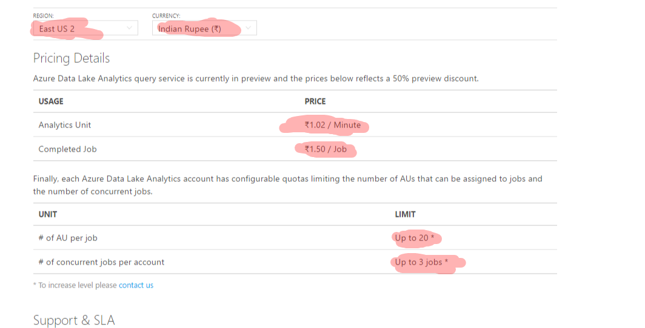
Pricing

Slide 35
Azure Data Lake Analytics (ADLA) Demo

Slide 36
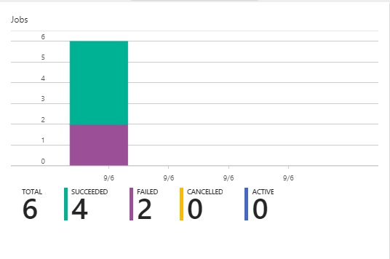

Slide 37
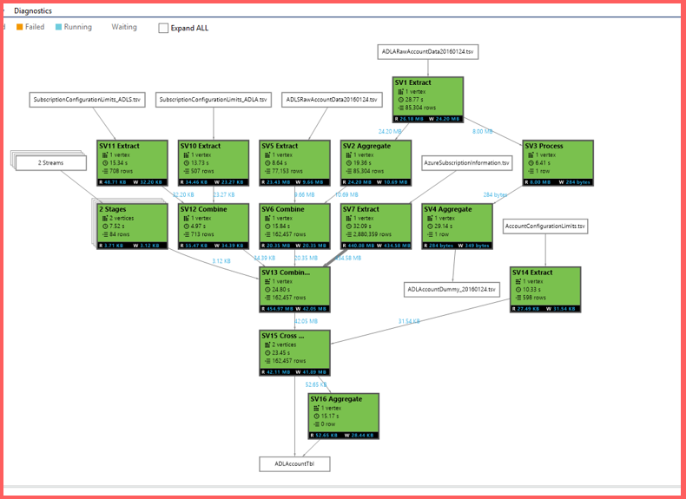

Slide 38
Job Scheduling States, Queue, Priority

Slide 39
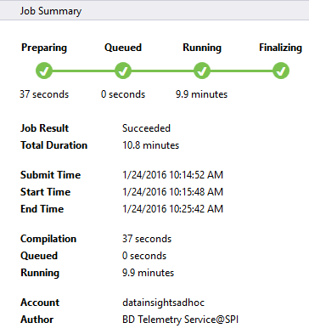
Job Status

Slide 40
UX
Job State
Preparing
New
The script is being compiled by the Compiler Service
Compiling
All jobs enter the queue.
Queued
Queued
Are there enough ADLAUs to start the job?
Scheduling
Starting
If yes, then allocate those ADLAUs for the job
Running
Running
The U-SQL runtime is now executing the code on 1 or more ADLAUs or finalizing the outputs
Finalizing
Ended
(Succeeded, Failed, Cancelled)
Ended
The job has concluded.

Slide 41
Preparing: Upload your script to the cloud, compiling and optimizing the script using the compile service.
Queued: Jobs are queued whey they are waiting for enough resources, or the jobs exceed the max concurrent jobs per account limitation. The priority setting determines the sequence of queued jobs - the lower the number, the higher the priority.
Running: The job is actually running in your Data Lake Analytics account.
Finalizing: The job is completing (for example, finalizing the file).
The job can fail in every phase. For example, compilation errors in the Preparing phase, timeout errors in the Queued phase, and execution errors in the Running phase, etc.

Slide 42
Why does a Job get Queued?
Local Cause
Conditions:
Queue already at Max Concurrency
Global Cause (very rare)
Conditions:
System-wide shortage of ADLAUs
System-wide shortage of Bandwidth
* If these conditions are met, a job will be queued even if the queue is not at its Max Concurrency

Slide 43
The Job Queue
When a job is at the top of the queue, it will start running.
Running jobs
The queue is ordered by job priority.
Lower numbers -> higher priority.
1 = highest.
Defaults:
Max Running Jobs = 3
Max Tokens per job = 20
Max Queue Size = 200

Slide 44
Priority Doesn’t Preempt Running Jobs
A
C
X
B
X has Pri=1.
These are all running and have very low priority (pri=1000)
X will NOT preempt running jobs. X will have to wait.

Slide 45
U-SQL Job Compilation

Slide 46
U-SQL Compilation Process
U-SQL Metadata Service
Compilation output (in job folder)
C#
managed dll
C++
Unmanaged dll
Compiler & Optimizer
Algebra
Other files
(system files, deployed resources)
Deployed to Vertices

Slide 47
The Job Folder
Inside the Default ADL Store:
/system/jobservice/jobs/Usql/YYYY/MM/DD/hh/mm/JOBID
/system/jobservice/jobs/Usql/2016/01/20/00/00/17972fc2-4737-48f7-81fb-49af9a784f64

Slide 48
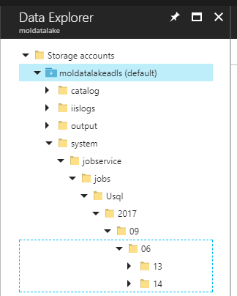
Job folder Structure
/system/jobservice/jobs/Usql/YYYY/MM/DD/hh/mm/JOBID

Slide 49
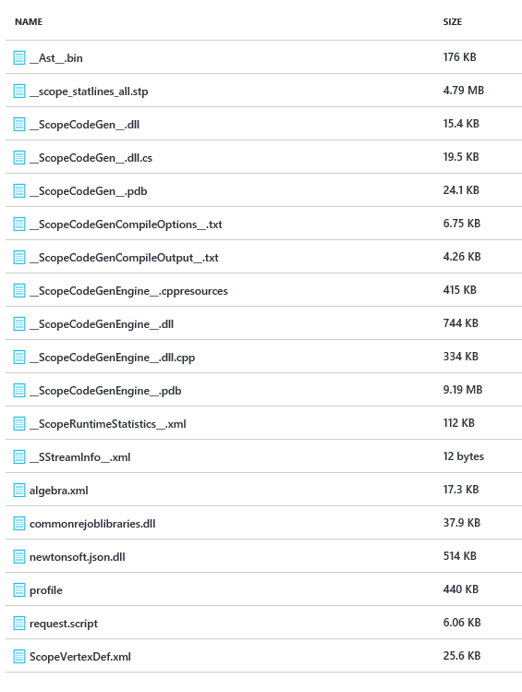
Job Folder Contents
C# code generated by the U-SQL Compiler
C++ code generated by the U-SQL Compiler
Cluster Plan a.ka. “Job Graph” generated by U-SQL Compiler
User-provided .NET Assemblies
User-provided USQL script

Slide 50
Query Execution Plans, Vertices, Stages, Parallelism, ADLAUs

Slide 51
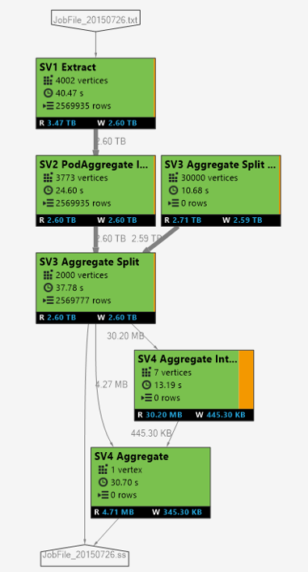
Logical -> Physical Plan
Vertexes in each SuperVertex (aka “Stage) are doing the same operation on different parts of the same data.
Vertexes in a later stages may depend on a vertex in an earlier stage
Each square = “a vertex” represents a fraction of the total
Visualized like this

Slide 52
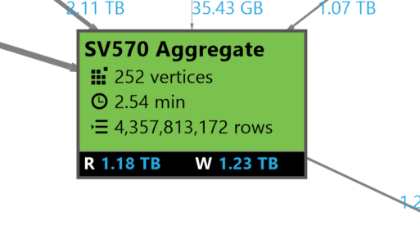
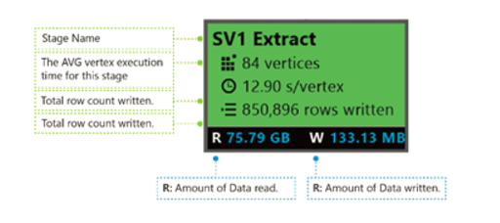
Stage Details
252 Pieces of work
AVG Vertex execution time
4.3 Billion rows
Data Read & Written

Slide 53
Coloring
Colors: Colors are used in the stage to indicate different vertex status.
Green indicates the vertex is succeeded.
Orange indicates the vertex is retried. The retried vertex was failed but is retried automatically and successfully by the system, and the overall stage is completed successfully. If the vertex retried but still failed, the color turns red and the whole job failed.
Red indicates failed, which means a certain vertex had been retried a few times by the system but still failed. This scenario causes the whole job to fail.
Blue means a certain vertex is running.
White indicates the vertex is Waiting. The vertex may be waiting to be scheduled once an ADLAU becomes available, or it may be waiting for input since its input data might not be ready.

Slide 54
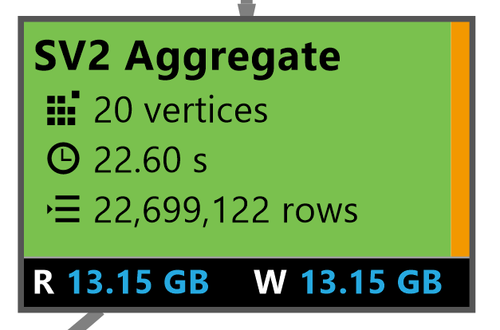
Automatic Vertex retry
A vertex failed … but was retried automatically
A vertex might fail because:
Router congested
Hardware failure (ex: hard drive failed)
VM had to be rebooted
U-SQL job will automatically schedule a vertex on another VM.
Overall Stage Completed Successfully

Slide 55
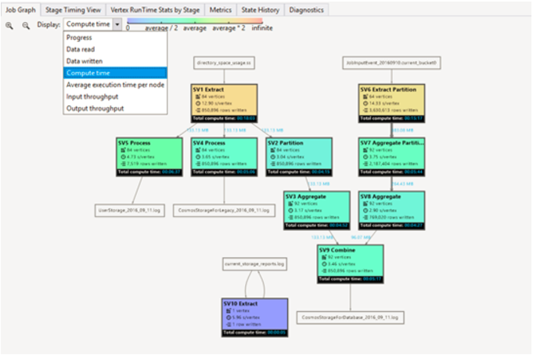
Coloring

Slide 56
ADLAUs
Azure
Data
Lake
Analytics
Unit
Parallelism N = N ADLAUs
1 ADLAU ~=
A VM with 2 cores and 6 GB of memory

Slide 57
Efficiency Cost vs Latency

Slide 58
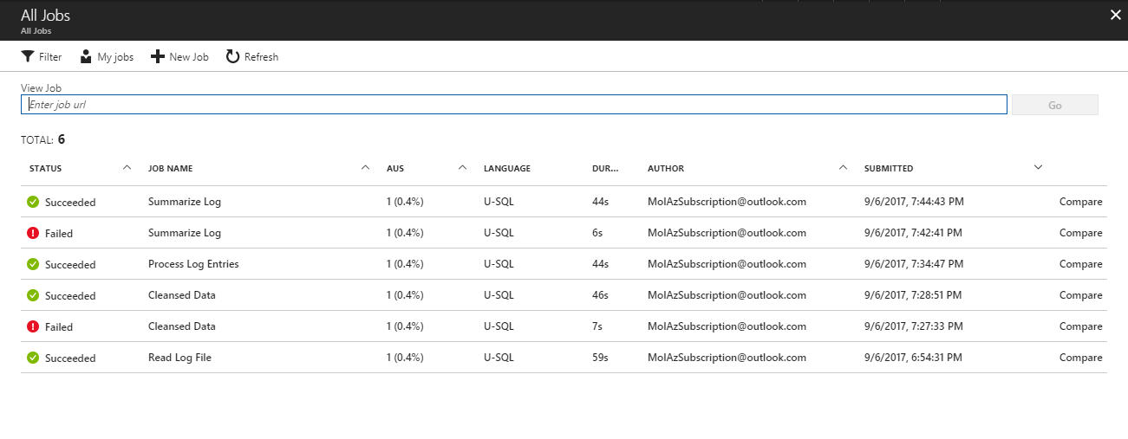

Slide 59
Allocation
Blue line: Allocated
Allocating 10 ADLAUs
for a 10 minute job.
Cost
= 10 min * 10 ADLAUs
= 100 ADLAU minutes
Time

Slide 60
Over Allocation
Consider using fewer ADLAUs
You are paying for the area under the blue line
You are only using the area under the red line
Time

Slide 61
Vertex Execution

Slide 62
Store Basics
A VERY BIG FILE
Files are split apart into Extents.
Extents can be up to 250MB in size.
For availability and reliability, extents are replicated (3 copies).
Enables parallelized read
1
2
3
4
5
1
2
3
4
5
1
2
3
4
5
1
2
3
4
5

Slide 63
Parallel writing
Front-end machines for a web service
Log files
Simultaneous
uploads
Azure Data lake

Slide 64
As file size increases, more opportunities for parallelism
Extent
Vertex
Extent
Vertex
Extent
Vertex
Extent
Vertex

Slide 65
The importance of partitioning input data

Slide 66
Search engine clicks data set
A log of how many clicks a certain domain got within a session
SessionID Domain Clicks
3 cnn.com 9
1 whitehouse.gov 14
2 facebook.com 8
3 reddit.com 78
2 microsoft.com 1
1 facebook.com 5
3 microsoft.com 11

Slide 67
Data Partitioning Compared
Extent 1
Extent 2
Extent 3
Extent 1
Extent 2
Extent 3
FB
FB
FB
FB
WH
CNN
WH
CNN
WH
CNN
WH
FB
WH
WH
CNN
FB
CNN
CNN
File:
Keys (Domain) are scattered across the extents
U-SQL Table partitioned on Domain
The keys are now “close together” also the index tells U-SQL exactly which extents contain the key

Slide 68
Click Data :
CREATE TABLE SampleDBTutorials.dbo.ClickData ( SessionId int, Domain string, Clinks int, INDEX idx1 //Name of index CLUSTERED (Domain ASC) //Column to cluster by ); INSERT INTO SampleDBTutorials.dbo.ClickData SELECT * FROM @clickdata;

Slide 69
Find all the rows for cnn.com
// Using a File
@ClickData =
SELECT
Session int,
Domain string,
Clicks int
FROM “/clickdata.tsv”
USING Extractors.Tsv();
@rows = SELECT *
FROM @ClickData WHERE Domain == “cnn.com”;
OUTPUT @rows
TO “/output.tsv”
USING Outputters.tsv();
// Using a U-SQL Table partitioned by Domain
@ClickData =
SELECT *
FROM MyDB.dbo.ClickData;
@rows = SELECT *
FROM @ClickData WHERE Domain == “cnn.com”;
OUTPUT @rows
TO “/output.tsv”
USING Outputters.tsv();

Slide 70
File
U-SQL Table Partitioned by Domain
CNN,
FB,
WH
CNN,
FB,
WH
CNN,
FB,
WH
FB
WH
CNN
EXTENT 1
EXTENT 2
EXTENT 3
EXTENT 1
EXTENT 2
EXTENT 3
Read
Read
Read
Read
Filter
Filter
Filter
Filter
Write
Write
Write
Write
Because “CNN” could be anywhere, all extents must be read.
Thanks to “Partition Elimination” and the U-SQL Table, the job only reads from the extent that is known to have the relevant key

Slide 71
How many clicks per domain?
@rows = SELECT
Domain,
SUM(Clicks) AS TotalClicks FROM @ClickData GROUP BY Domain;

Slide 72
File
U-SQL Table Partitioned by Domain
FB
WH
CNN
CNN,
FB,
WH
CNN,
FB,
WH
CNN,
FB,
WH
EXTENT 1
EXTENT 2
EXTENT 3
EXTENT 1
EXTENT 2
EXTENT 3
Read
Read
Read
Read
Read
Read
Partial Agg
Partial Agg
Partial Agg
Full Agg
Full Agg
Full Agg
Partition
Partition
Partition
Write
Write
Write
Expensive!
Full Agg
Full Agg
Full Agg
Write
Write
Write

Slide 73
END

Slide 74
Data Quality
Most Complex in Big Data

Slide 75
What are the challenges in data quality on Azure Big Data systems..
Data Quality
Vision
Data volume and velocity is at a high pace and non-relational too..
Manual validation and QC is beyond the scope ..
Lack of traditional policy checks like PKs, FKs, etc.
Putting together ACID rules is hard
Data counts needs to be continuously checked..
Need to know the freshness of billions of data..
Need to ensure data coverage of transition of millions records across storage layers
Data moves between relational and non-relational stores and ensuring consistency
1
Develop a generic data quality engine that can run on Azure and capable of verifying data against multiple data sources including Azure DBs, Azure Data Lake, HDInsights, Warehouses and MDX Cubes
2
3
4
Distributed business rules..
Data is processed at multiple stages and faults can occur anywhere..
Goals
Support multiple connectors
Fully automated testing
Dynamic scalability
Centralized Governance
Team & Reports friendly
5
Lack of validation tools
No ready available tools like Performance tester etc.
6

Slide 76
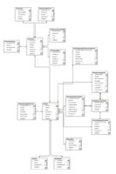
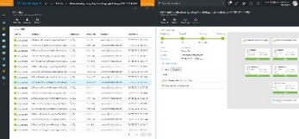
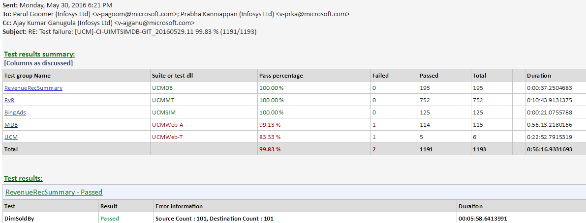
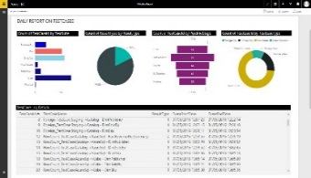
Data flow diagram of the Data Quality engine
Data Quality
Data Quality
Test Cases Storage
Heart & Engine
Data Quality Engine enabled to validate most of rules likes value checks, primary key checks, row count checks etc.
Comprehensive work flow for authoring, execution and monitoring for Azure Data warehouse and Azure Data Lake , HDInsight's , Spark
Automated Testing with daily mails to all the stake holders
Live Power BI dashboards for analyzing the quality of the system
Test Case Authoring Engine
Test Case Scheduling
Test Case Flags
PowerShell Engine
Execute on
ADL
ADW
DB
Files
Triggering Process
Telemetric Data Visualization
Emails with Logs
Action on Bugs
Missing test cases
Live Visualization
View Logs
View Exceptions

Slide 77
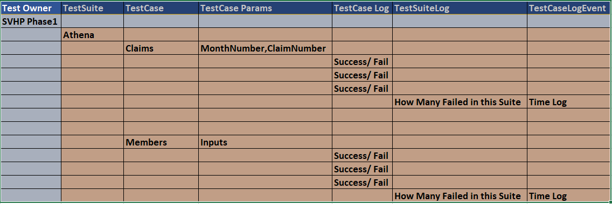
Phase 2 - Validation Storage
Notes:
Will Require SVHP Support for Test Cases on what basis they do .

Slide 78
Data Validation Checks
Data File Check .
Format Check
File Header Check
File availability check in All levels.
Data Functional Check
Value check
All Ups checks from source and destination values.
Data movement
Data count check
Duplicates check
Primary Key Check
Foreign Key Check
Data File Name Check
Transformed data check
Mid Level Value checks

Slide 79
Data Quality
What are the rules validated and many more custom checks
SOURCES/
PRODUCERS
STAGING
Blob/ADLS
CLEANSING
/ENRICHMENT
TRANSFORMATION
ADLA / HDInsight
RDBMS
ADW
CACHED
VIEWS/SPs
PIVOTS
Cube
PRESENTATION/
ACTIONS
Data availability
PrimaryKey Check
Value Check
Missing/ New Column
Data Length Check
Foreign Key Check
Monthly Functional Checks
ADW and Presentation Checks
Data Format
Missing Value
Data Type Check
Dev/Prod Checks
File Header
Analysis Service with Source Check
File Name
Duplicate Row Check
Count Check
Dependency Check
All the rules above are automated using a custom PowerShell engine
79

Slide 80
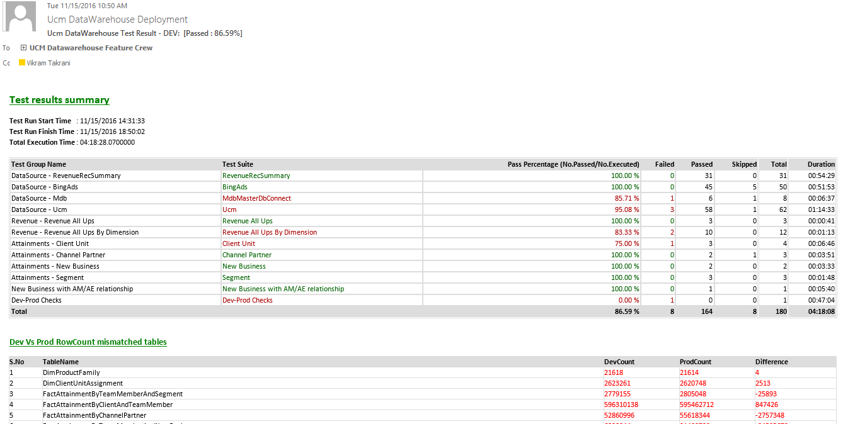
Daily Validation status in email
Program Highlights

Slide 81
Handling 1 TB

Slide 82
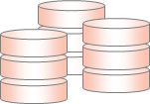


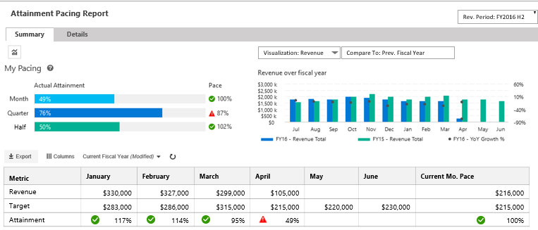
Architecture
Architecture Overview of UCM-B
SOURCES/
PRODUCERS
COLLECTION / STAGING
MERGE/CLEANSING
/ENRICHMENT
TRANSFORMATION
BUSINESS RULES
CACHED VIEWS
PIVOTS
PRESENTATION/
ACTIONS
Azure Data Factory
[ Data Ingestion, Layers Orchestration and Data Auditing]
Staging Area Subscriber
[Accounts, Customer, Exchange rates, etc.]
ETL
Adhoc Engines
Azure Data Lake
ADW
MDX CUBE
KPIs, Metrics Hierarchy
ADLS STAGING
WARM
Business
Users
Confirmed Dimensions
Date, Product, etc.
Optimized for 2 year
SQL Sources
PAAS: UCM
On-Premise : MDB
SQL Server Gateway
USQL
ADLS STAGING
WARM
Dimensions
Customer, Account, ..
Delta Merges
Business Reporting Views
UCM-B Business Reporting Web site
Analysis Services
RvR Cube
PowerShell Upload
Facts
Revenue, Attainments,
Relational DW
Account Teams
ADLS as TSV
[Archived daily]
Maps
Account-CU, Timeline
Cached Data
WWIC Flat Files
Structured Files
[KPIBillingCube]
WWIC Views
COLD
USQL
HYBRID PROCESSING
WWIC Teams
HYBRID STORAGE [BLOB/DB]
NORMALIZE
METRICS ENGINE
REPORTING and UIX

Slide 83

Data Flows & Pipelines
Data sources & Pipelines in UCM-B
SOURCES/
PRODUCERS
STAGING
ADLS
CLEANSING
/ENRICHMENT
TRANSFORMATION
ADLA / USQL
RDBMS
ADW
CACHED
VIEWS
PIVOTS
Cube
PRESENTATION/
ACTIONS
Accounts
Customer
Exchange
Staging Area Subscriber
FULL FILE
MERGING
CATALOG
TABLE(S)
1
ATTAINMENTS
--------------------
CLIENT UNIT
SEGMENT
NEW BUSINESS
CHANNEL PARTNER
MDX Cube
Timeline
MDB
FULL FILE
MERGING
CATALOG
TABLE(S)
2
Assignments
Quotas
Teams
UCM
FULL FILE
MERGING
CATALOG
TABLE(S)
3
6
Gross, Net, Billed
RvR
WWIC VIEWS
WWIC Hand off DB
[FUTURE]
WWIC Flat Files
FULL DATA
DEGENERATION
CATALOG
TABLE(S)
4
8
Revenue
REVENUERECSUMMARY
INCR FILE
DEGENERATION
CATALOG
TABLE(S)
UCM BUSINESS REPORTING
5
BUSINESS REPORTING
7

Slide 84
Data Flows & Pipelines
Program Overview
1
UCM-B Staging Area Subscriber Pipeline
SOURCES/
PRODUCERS
STAGING
ADLS
CLEANSING
/ENRICHMENT
TRANSFORMATION
ADLA / USQL
RDBMS
ADW
CACHED
VIEWS
PIVOTS
Cube
PRESENTATION/
ACTIONS
Accounts
Customer
Exchange
Staging Area Subscriber
ATTAINMENTS
--------------------
CLIENT UNIT
SEGMENT
NEW BUSINESS
CHANNEL PARTNER
FULL FILE
MERGING
CATALOG
TABLE(S)
MDX Cube
FULL
Initial Storage Size
Data Period
# Rows
Time
~2 GB
All Accounts, Customer, Exchange, Data..
15 Million Rows
3 Days
~1 GB
Last 1 year
15 Million
1 Day [POLYBASE]
.5 GB
All Masters
15 Million
15 minutes
INCREMENTAL
Initial Storage Size
Data Period
# Rows
Time
~2 GB
All Accounts, Customer, Exchange, Data..
15 Million Rows
45-60 minutes
~ 150 KB
6 hours
2000 +
20 minutes
~100 KB
1 Day incremental
1000+
4-5 minutes
84

Slide 85
Program Overview
Data Flows & Pipelines
2
UCM-B MDB Pipeline
SOURCES/
PRODUCERS
STAGING
ADLS
CLEANSING
/ENRICHMENT
TRANSFORMATION
ADLA / USQL
RDBMS
ADW
CACHED
VIEWS
PIVOTS
Cube
PRESENTATION/
ACTIONS
ATTAINMENTS
--------------------
CLIENT UNIT
SEGMENT
NEW BUSINESS
CHANNEL PARTNER
MDX Cube
Timeline
MDB
FULL FILE
MERGING
CATALOG
TABLE(S)
FULL
Initial Storage Size
Data Period
# Rows
Time
2.5 GB
Account Time for last 16 months
11 Million Rows
1 hour
1 GB
16 months
11 Million
1 hour
0.5 GB
16 months
11 Million
15 minutes
INCREMENTAL
Initial Storage Size
Data Period
# Rows
Time
2.5 GB
Account Time for last 16 months
11 Million Rows
1 hour
~10 MB
1 day
1000+
15 minutes
[INCREMENTAL MERGE]
~100 KB
1 Day incremental
1000+
5-6 minutes
85

Slide 86
Program Overview
Data Flows & Pipelines
3
UCM-B Quota and BoB Pipeline
SOURCES/
PRODUCERS
STAGING
ADLS
CLEANSING
/ENRICHMENT
TRANSFORMATION
ADLA / USQL
RDBMS
ADW
CACHED
VIEWS
PIVOTS
Cube
PRESENTATION/
ACTIONS
Assignments
Quotas
Teams
UCM
ATTAINMENTS
--------------------
CLIENT UNIT
SEGMENT
NEW BUSINESS
CHANNEL PARTNER
MDX Cube
FULL FILE
MERGING
CATALOG
TABLE(S)
FULL
Initial Storage Size
Data Period
# Rows
Time
5 GB
5 months [from July 2016]
>10 million rows
1 hour
2.5 GB
5 months
10 Million
1 hour
1 GB
5 months
10 Million
20 minutes
INCREMENTAL
Initial Storage Size
Data Period
# Rows
Time
5 GB
5 months [from July 2016]
>10 million rows
20 minutes
Few MB
1 day
~1000
10 minutes
Few MB
1 day
~1000
10 minutes
86

Slide 87
Data Flows & Pipelines
Program Overview
4
UCM-B RvR Pipeline
SOURCES/
PRODUCERS
STAGING
ADLS
CLEANSING
/ENRICHMENT
TRANSFORMATION
ADLA / USQL
RDBMS
ADW
CACHED
VIEWS
PIVOTS
Cube
PRESENTATION/
ACTIONS
Gross, Net, Billed
RvR
ATTAINMENTS
--------------------
CLIENT UNIT
SEGMENT
NEW BUSINESS
CHANNEL PARTNER
MDX Cube
FULL DATA
DEGENERATION
CATALOG
TABLE(S)
FULL
Initial Storage Size
Data Period
# Rows
Time
Few MB
Data records from 2009
Few thousand
1 Day
100 MB
7 years
~ 2000 records
15 minutes
100 MB
7 Years
~2000 records
10 minutes
INCREMENTAL
Initial Storage Size
Data Period
# Rows
Time
Few MB
Data records from 2009
Few thousand
Every Month
100 MB
7 years
~ 2000 records
15 minutes
100 MB
7 Years
~2000 records
10 minutes
87

Slide 88
Data Flows & Pipelines
Program Overview
5
UCM-B RevenueRecSummary Pipeline
SOURCES/
PRODUCERS
STAGING
ADLS
CLEANSING
/ENRICHMENT
TRANSFORMATION
ADLA / USQL
RDBMS
ADW
CACHED
VIEWS
PIVOTS
Cube
PRESENTATION/
ACTIONS
Revenue
REVENUERECSUMMARY
INCR FILE
DEGENERATION
CATALOG
TABLE(S)
ATTAINMENTS
--------------------
CLIENT UNIT
SEGMENT
NEW BUSINESS
CHANNEL PARTNER
MDX Cube
FULL
Initial Storage Size
Data Period
# Rows
Time
800 GB
16 Months
3.6 Billion Rows
3 Days
180 GB
16 Months
3.6 Billion Rows
3 Days [POLYBASE]
30 GB
16 Months
1.8 Billion Rows
3 Hours
INCREMENTAL
Initial Storage Size
Data Period
# Rows
Time
6 GB
1 Day
3-5 Million Rows
90 minutes
.5 GB
1 Day
3-5 Million Rows
30 minutes
100 MB
1 Day
1-2 Million Rows
15-20 minutes
88

Slide 89
Program Overview
Data Flows & Pipelines
UCM-B Data Pipelines view - Overall
SOURCES/
PRODUCERS
COLLECTION / STAGING
[Azure Data Lake Storage]
CLEANSING
/ENRICHMENT
TRANSFORMATION/
BUSINESS RULES/
CACHED VIEWS
PIVOTS
PRESENTATION/
ACTIONS
Accounts
Staging Area Subscriber
Azure Data Factory [Data Ingestion, Layers Orchestration and Data Auditing]
Timeline
MDB
ADHOC & Reporting Engines
Assignments
Quotas
Teams
UCM
AZURE SSAS SERVICE
USQL
SQL
AZURE DATA WAREHOUSE
AZURE DATA LAKE
AZURE IAAS (SQL 2016)
ADLS
Azure Storage
Data Cleansing,
Data Processing (USQL)
Data Archival
Data Catalog
Relational DW
Star Schema
Pre-cached Views
Business Reporting Views
MDXCube
Measures
KPIs
UCM-B Business Reporting Web site
RvR
REVENUERECSUMMARY
Full Total Storage /
Full Data Period /
# Rows
1.2 TB / 16 Months
1.2 TB / 16 Months
1.2 TB / 16 Months /
8 Billion
80 GB/ 16 Months /
2.5 billion
Incremental Storage /
Incremental Period /
Processing Time
10 GB/ 1 day / 2 Hours
5 GB/ 1 day / 1 Hour
2.5 GB/ 1 day / 1 Hour
1 GB/ 1 day / 2 hr.
RESTATEMENT
400 GB /6 months/
7-12 Hours
40 GB/ 6 months / 4 hr.

Slide 90
UCM-B Simplified Data Flow
SOURCES/
PRODUCERS
COLLECTION / STAGING
[Azure Data Lake Storage]
CLEANSING
/ENRICHMENT
TRANSFORMATION/
BUSINESS RULES/
CACHED VIEWS
PIVOTS
PRESENTATION/
ACTIONS
MDB
ADCRM
ON PREMISE
Azure Data Factory [Data Ingestion, Layers Orchestration and Data Auditing]
VM
USQL
SQL
AZURE DATA WAREHOUSE
SQL Server 2016 on VM
ADLS
Azure Storage
AZURE DATA LAKE
ADHOC & Reporting Engines
Data Cleansing
Data Enrichment
Type 2 Dimensions
Data Archival
Attainments
Business Reporting Views
WWIC Views
Opportunities
..
Billing Cube
Bing Ads
Ucm
Exchanges
AZURE SQL
DB
Business Reporting Web App
Azure SQL
KPI Billing
FLAT FILES
Business Reporting
DB
Monetization
Clicks
Impressions
Budget Pause
Accounts
COSMOS
WWIC Feeds
[EXCEL]
INCR/FULL DATA

Slide 91
Archival
Archival View in UCM-B per instance [Bottom grey layer is the archival size]
SOURCES/
PRODUCERS
COLLECTION / STAGING
MERGE/CLEANSING
/ENRICHMENT
TRANSFORMATION
BUSINESS RULES
CACHED VIEWS
PIVOTS
PRESENTATION/
ACTIONS
Azure Data Factory
[ Data Ingestion, Layers Orchestration and Data Auditing]
Staging Area Subscriber
[Accounts, Customer, Exchange rates, etc.]
ETL
Adhoc Engines
Azure Data Lake
ADW
MDX CUBE
KPIs, Metrics Hierarchy
ADLS STAGING
WARM
Business
Users
Confirmed Dimensions
Date, Product, etc.
Optimized for 2 year
SQL Sources
PAAS: UCM
On-Premise : MDB
SQL Server Gateway
USQL
ADLS STAGING
WARM
Dimensions
Customer, Account, ..
Delta Merges
Business Reporting Views
UCM-B Business Reporting Web site
Analysis Services
RvR Cube
PowerShell Upload
Facts
Revenue, Attainments,
Relational DW
Account Teams
ADLS as TSV
[Archived daily]
Maps
Account-CU, Timeline
Cached Data
WWIC Flat Files
Structured Files
[KPIBillingCube]
WWIC Views
COLD
USQL
HYBRID PROCESSING
WWIC Teams
HYBRID STORAGE [BLOB/DB]
NORMALIZE
METRICS ENGINE
REPORTING and UIX
~500 GB
Revenue files last 6 months
~500 GB
ADLS stg files last 6 months
~200 GB
ADLS processed files last 6 months
~80 GB
Per day
~100 MB
Per batch

Slide 92
NFR view in UCM-B
SOURCES/
PRODUCERS
COLLECTION / STAGING
MERGE/CLEANSING
/ENRICHMENT
TRANSFORMATION
BUSINESS RULES
CACHED VIEWS
PIVOTS
PRESENTATION/
ACTIONS
Azure Data Factory
[ Data Ingestion, Layers Orchestration and Data Auditing]
Staging Area Subscriber
[Accounts, Customer, Exchange rates, etc.]
Fast ETL
Adhoc Engines
Azure Data Lake
ADW
MDX CUBE
KPIs, Metrics Hierarchy
ADLS STAGING
HOT
Business
Users
Confirmed Dimensions
Date, Product, etc.
Optimized for 2 year
SQL Sources
PAAS/On-Prem
[MDB, UCM, etc.]
SQL Server Gateway
USQL
ADLS STAGING
Dimensions
Customer, Account, ..
Delta Merges
WARM/COLD
Analysis Services
RvR Cube
PowerShell Upload
Facts
Revenue, Attainments,
Relational DW
Business Reporting Views
UCM-B Business Reporting Web site
ADLS as TSV
[Archived daily]
Maps
Account-CU, Timeline
Cached Data
Account Teams
Structured Files
[KPIBillingCube]
WWIC Views
COLD
USQL
HYBRID PROCESSING
HYBRID STORAGE [BLOB/DB]
NORMALIZE
METRICS ENGINE
REPORTING and UIX
AZURE CAPABILITIES
ENCRYPTION
SECURITY
DATA QUALITY
TELEMETRY
LOGGING
ERROR HANDLING
WORK FLOWS
GOVERNANCE
META-DATA
LINEAGE
AUDITS
REPORTS
ALERTS
ROLES
RULES

Slide 93

What is the criteria in choosing a ‘high-performance’ data platform for UCM-B
Design & Engineering
 | Azure DW | Azure Data Lake | COSMOS
 | SQL Azure DWH – PAAS solution with elastic scale for performance/scalability Central DWH contains granular data | Azure Data Lake store/analytics aligning to Cortana Analytics Suite | COSMOS Data store for processing/storing data
Volume | Traditional central EDW is known to work for the projected volume but may not be optimal with data size of 1-2 TB | Physically partitioned data and hence can accommodate higher volumes. | Designed for high volume data warehouses.
Load Performance | Load performance can be matched with increased DTUs but comes with cost | Parallel processing with MPP results in better performance and performance can be boosted with increased DTUs | Parallel processing with Map-Reduce results in better performance.
Data Access | Access is easier. Query performance can be an issue. | Easier and data access through USQL other standard open source. | Data access restricted through Scope scripts
Scalability | 4-5 TB SQL Azure node has to be partitioned to multiple DBs | Can be scalable by adding more logical partitions for new data source/growth | Good Scalability
Strategic Alignment | Aligns with Cortana Analytics suite recommendation | Aligns with Cortana Analytics suite recommendation and strategy to migrated from COSMOS to ADL | With latest development with strategy to move to Azure Data Lake
Complexity | Simplest of the 3 approaches | Development and Complexity higher for configurable calculation engine | Development and Complexity higher for configurable calculation engine
Cost | Cost assuming a 4-5 TB size will be around $7000/TB | Medium considering Azure Data Lake instance and worker role process | Medium - High
Security Compliance | Storing PII/HBI data through encryption/ decryption modules | ADL support storing PII/HBI data at rest through OOB functionality | PI information in a common environment will not comply and has to do custom coding
Good Fit
Workaround Needed
Not Good Fit

Slide 94

Data Ingestion and Orchestration needs…
We had the challenge to find a right solution that can
Ingest millions of records per day
Orchestrate with On-Premise sources like SQL Servers and Cosmos, as well as cloud sources like SQL Azure databases
Have inbuilt capability to process data ‘as-is’ including files, databases, services etc.
We have chosen Azure Data Factories for ingestion and orchestration..

Slide 95
And also compared with Azure HD Insight
Cosmos
ADW
ADL
HD Insight
Storage
Capacity Constraints
Unlimited seamless scale
Unlimited seamless scale
Unlimited seamless scale
✓
✓
✓
✓
Compute
Capacity Constraints
Unlimited seamless scale
Unlimited scale post GA
Unlimited seamless scale
X
✓
✓
✓
Ecosystem/ Tooling
Minimal learning curve
Minimal learning curve
Minimal learning curve
3rd party tools learning curve
✓
✓
✓
~
Strategic Alignment
On migration path to ADL
PaaS service from Microsoft
PaaS service from Microsoft
Quasi-IaaS offering
~
✓
✓
~
Supportable
Internal, requires multiple layers.
Product Support
Product Support
Product Support
~
✓
✓
✓
Maturity
Lots of usage. Some instability
V1 Technology
Under Preview
Too many Tools
~
~
~
~
Compliance
Doesn’t support TDE
Supports TDE
Support for TDE in GA
Supports encryption
~
✓
✓
✓
No DIRECT driver
Direct Queries
PoC Needed
SQOOP [3rd party]
Ease of Consumption
X
✓
~
~
No support for SQL
FULL Compatible
Mostly Compatible
Full Re-work to HiveQL + Java
Business Logic Reuse
X
✓
~
X
Initial Set-up
No more tokens
Azure
Easy migration to ADF, U-SQL
Requires Data Migration
X
✓
~
X
Conclusion
REJECTED
ACCEPTABLE
ACCEPTABLE
REJECTED
X
✓
✓
X
Notes:
Product Comparison table template with four product columns in PowerPoint

Slide 96



.
Design & Engineering
Key Learnings from Engineering
Data Volume
How do we ensure the combined volume of UCM-B data can be managed effectively in a Centralized Data Warehouse ?
Considering the combined data volume from UCM-B platform and the future growth, we will apply the concepts of HOT and COLD path for active data processing and historical data storage.
60% of the total data volume is older than a year. This will be managed as Flat files in Azure Storage with an option to load on-demand using Polybase/USQL
This effectively makes the ACTIVE Data warehouse efficient and highly performing.
Security
How do we ensure the data security of UCM-B Centralized Data Warehouse ?
Data Masking, Encryption and Transparent Data Security will ensure the data security for HBI data
Down stream requirements where row-level security is required shall be replicated as satellite databases with Azure SQL and data managed
All access shall be centrally managed with AAD (Azure Active Directory) Service Accounts
Geo-Availability
How do we ensure the high-volume availability requirement for all the end users?
ADW can be replicated onto multiple servers within a few minutes based on the load patterns of down streams
Dynamic scalability can be provided based on Geo-proximity for faster data access
Orchestration
& Schedules
How do we ensure the combined data sources will not impact the overall processing time?
With increased number of data sources, multiple data pulls will be managed by Azure Data Factories in parallel
Fast-Data concepts ensure data is cleansed within the pipelines and is available faster thereby avoiding multiple data hops.
Down-streams
How do we ensure the connectivity of down-streams?
ADW works similar to SQL Server and works the same with a connection string and access control
It is similar to a Server upgrade and most of the down streams will not be impacted

